Slide 1
Plan B Final Presentation of Smart-Gantt
Hind Almushigih
May 3, 2016
Presented in partial fulfillment for the requirements for the degree Master of Science in Computer and Information Science
Major: Software Engineering
Plan-B Option: Technical
Advisor: Dr. Stephen T. Frezza
Completion Semester: SP 16
Committee members:
Dr. Barry J. Brinkman
Dr. Theresa M. Vitolo

Slide 2
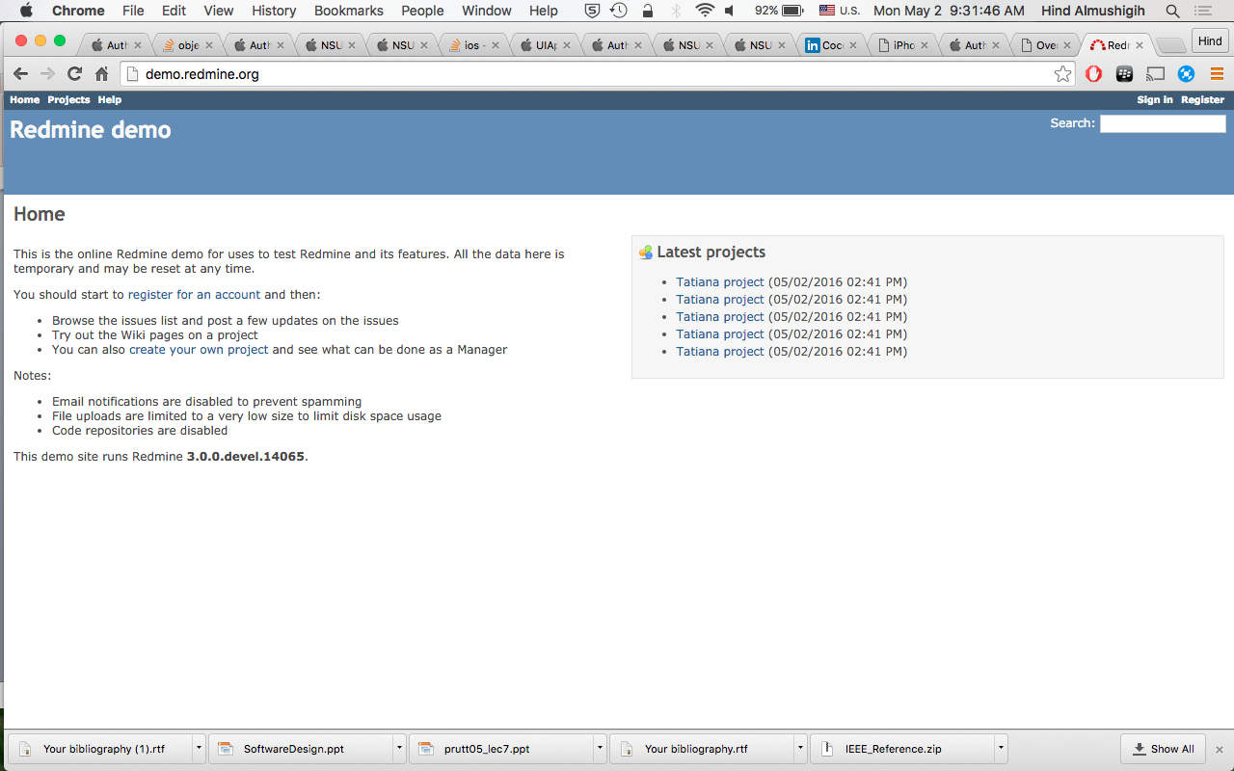
RedMine™: http://www.redmine.org/
Flexible project management web application
Multiple projects support
Gantt chart and calendar
Time tracking
Cross-platform and cross-database
Public open-source code
Actively maintained

Slide 3
OBJECTIVES
Build an iOS app to extend the Redmine™ web application.
Dynamic GANTT
Mobile UI for to choose the range of a dates for task
Late feature- Support access to any Redmine™ URL server that the user provides.

Slide 4

Smart-Gantt
Extension to Project Management tool (RedMine™)
Alternative to the web application
Smart Gantt support these features now:
Dynamic GANNT
Date Selection for Issue
URL server change

Slide 5
CHANGE REQUESTS
Change category:
Deliverable Scope
Move the Notification feature (Scheduling an event) to feature plan.
Extend the features of the Gantt chart and deliver it to be more flexible – Smart Gantt
Emphasize code design as a reusable library

Slide 6
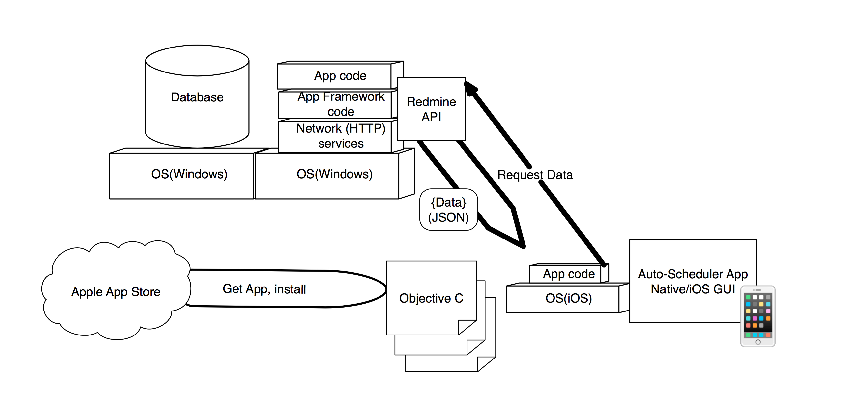
System Architecture
Redmine Server

Slide 7
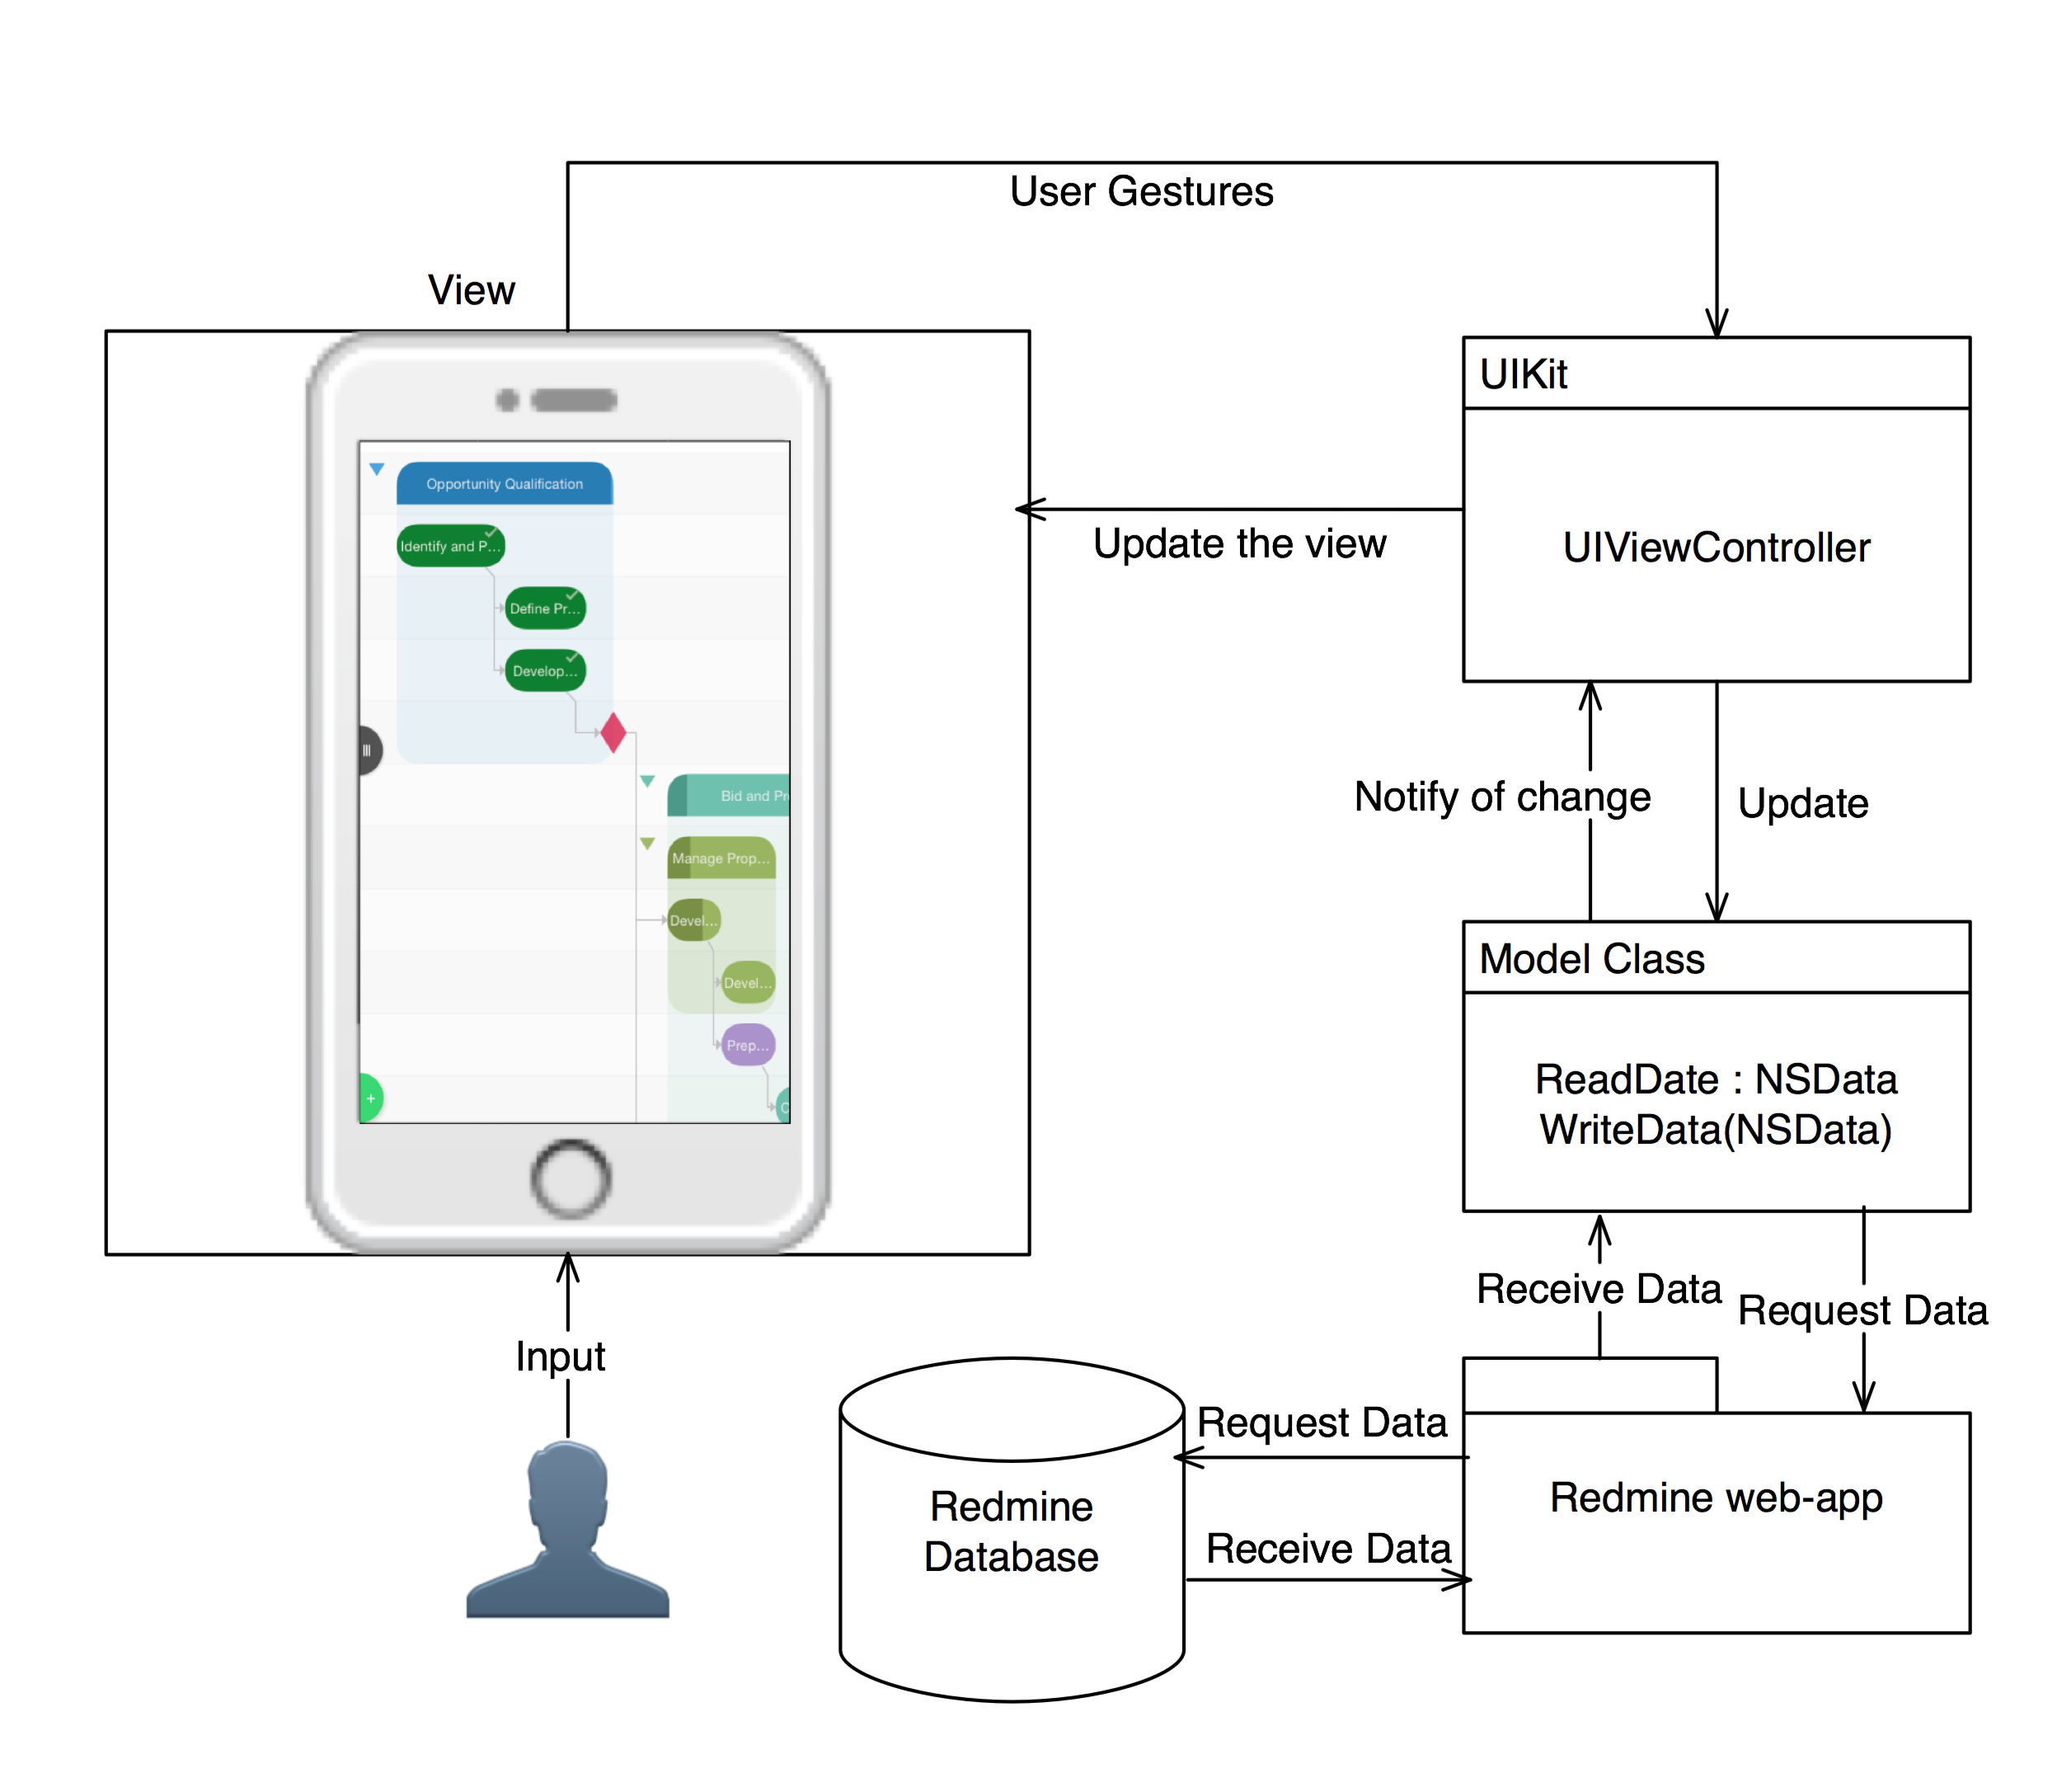
1: DYNAMIC GANTT Design (MVC)

Slide 8
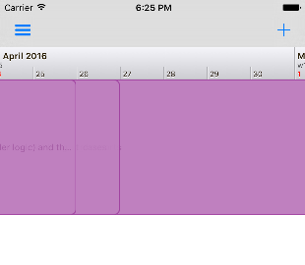
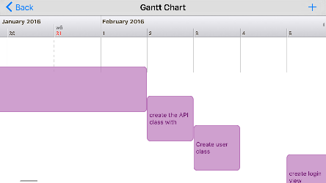
DYNAMIC GANTT IQWIDGETS LIBRARY

Slide 9
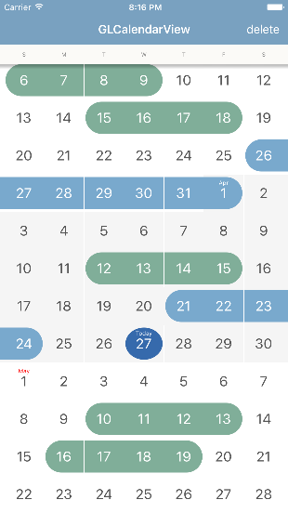
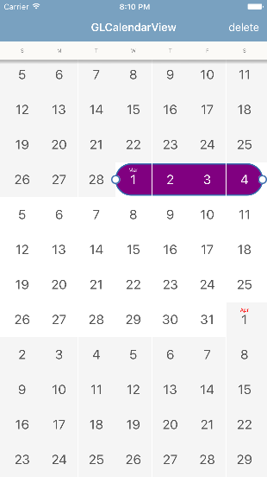
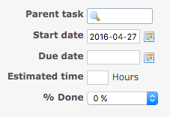
2: DATE SELECTION FOR ADDING ISSUE

Slide 10
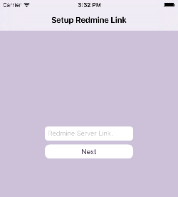
Late Feature: URL SERVER CHANGE
Allows Redmine™ users to configure URL.
Useable with any Redmine™ server available to the device.

Slide 11
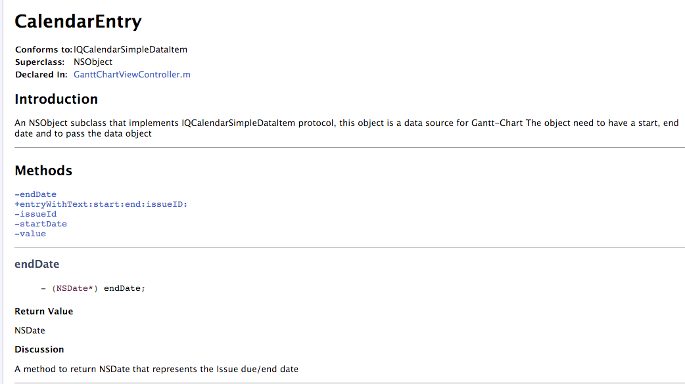
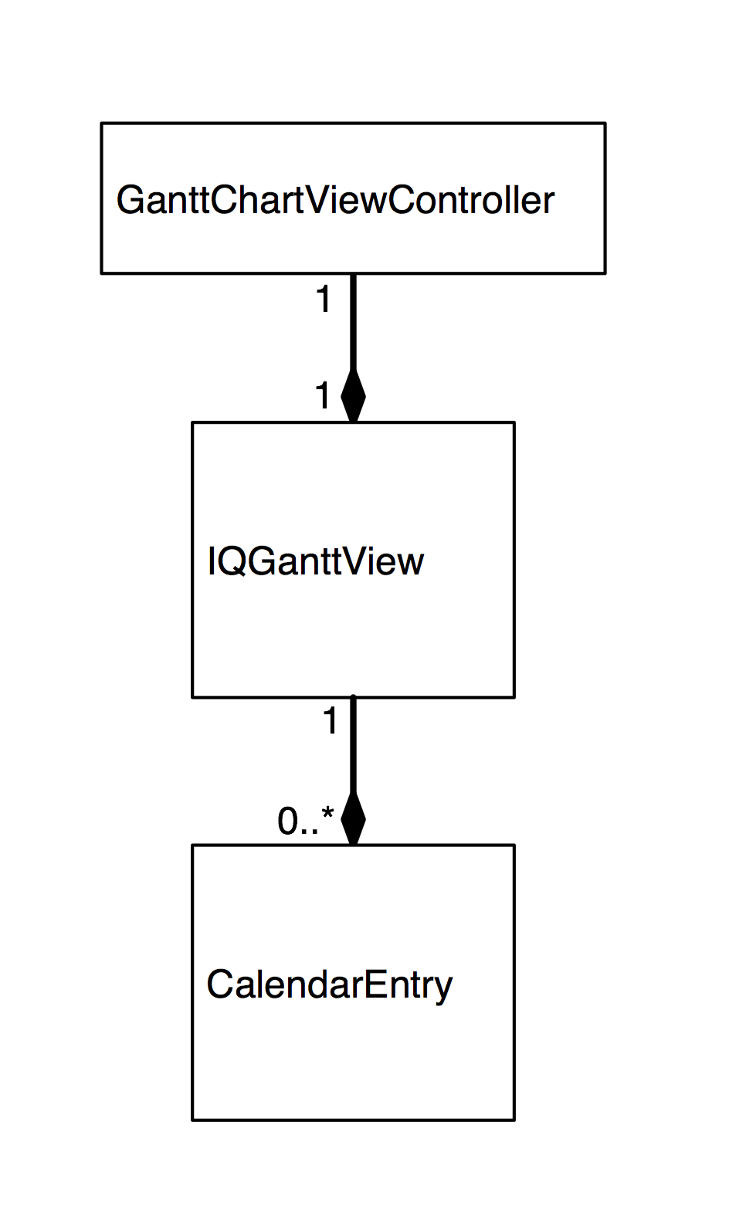

Software Design
Smart Gantt Software Design
Packaging for reuse
@discussion
@param
@return
CalendarEntry class, can be reused in any xcode project as data source for Gantt-Chart view(The label).
Generate HTML file using HeaderDoc command line

Slide 12
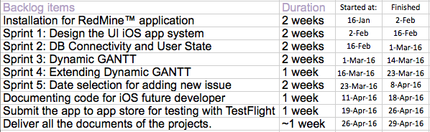
Project planning & management

Slide 13
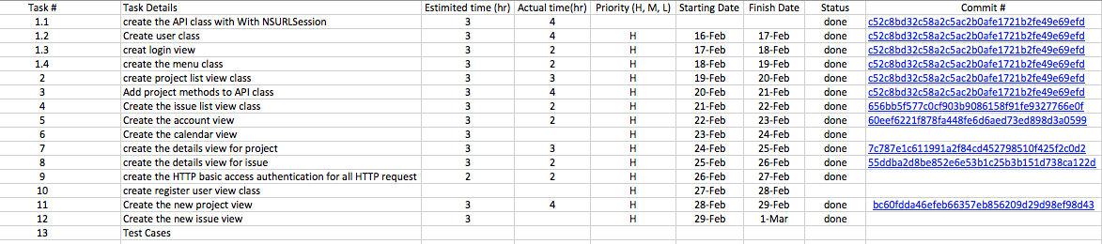
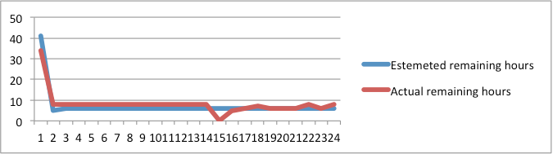
QUALITY ASSURANCE | Sample Sprint
As an example: Sprint 2:
Burn down charts
Error handling
github

Slide 14
USER AND SOFTWARE TESTING
Develop body of UITesting
Xcode recording
Delivered with each sprint
Utilize TestFlight from Apple to enable distribution of Beta versions
VPN access
Code the VPN
Public server
Dynamic test
Run, build check functionality list.

Slide 15
DEMO
Run Xcode project

Slide 16
FUTURE WORK
Notification.
Scheduling an event.
Admin functionality.
Source code control for iOS developer. (support).

Slide 17
MEASURES of SUCCESS
80% of users should express positive comments about the dynamic GANTT.
Comparing the capability of gantt-chart on redmine server and the app.
90% of iOS developers will understand the block of the code and recognize how to reuse it to match their data.
Matthew Mashyna feedback

Slide 18
Any Question?

Slide 19
Thank you
Hind

